Slide 1
Chapter 14: Transactions

Slide 2
Chapter 14: Transactions
Transaction Concept(事务概念)
Transaction State（事务状态）
Concurrent Executions（并发执行）
Serializability（可串行化）
Recoverability（可恢复性）
Implementation of Isolation（隔离性的实现）
Transaction Definition in SQL（SQL中的事务定义）
Testing for Serializability.（可串行性测试）

Slide 3
Transaction Concept
A transaction is a unit of program execution that accesses and possibly updates various data items.（访问&可能更新各数据项的程序执行单元）
E.g. transaction to transfer $50 from account A to account B:
1. read(A)
2. A := A – 50
3. write(A)
4. read(B)
5. B := B + 50
6. write(B)
Two main issues to deal with:
Failures of various kinds, such as hardware failures and system crashes
Concurrent execution of multiple transactions

Slide 4
Example of Fund Transfer
Transaction to transfer $50 from account A to account B:
1. read(A)
2. A := A – 50
3. write(A)
4. read(B)
5. B := B + 50
6. write(B)
Atomicity requirement（原子性）
if the transaction fails after step 3 and before step 6, money will be “lost” leading to an inconsistent database state（事务在第3至第6步失败）
Failure could be due to software or hardware
the system should ensure that updates of a partially executed transaction are not reflected in the database（系统应该保证事务的局部执行不影响正确性）
Durability requirement （持久性） — once the user has been notified that the transaction has completed (i.e., the transfer of the $50 has taken place), the updates to the database by the transaction must persist even if there are software or hardware failures.（一旦修改，保持不变）

Slide 5
Example of Fund Transfer (Cont.)
Transaction to transfer $50 from account A to account B:
1. read(A)
2. A := A – 50
3. write(A)
4. read(B)
5. B := B + 50
6. write(B)
Consistency requirement（一致性） in above example:
the sum of A and B is unchanged by the execution of the transaction
In general, consistency requirements include
Explicitly specified integrity constraints such as primary keys and foreign keys
Implicit integrity constraints（完整性约束）
e.g. sum of balances of all accounts, minus sum of loan amounts must equal value of cash-in-hand
A transaction must see a consistent database.
During transaction execution the database may be temporarily inconsistent.（暂时）
When the transaction completes successfully the database must be consistent
Erroneous transaction logic can lead to inconsistency

Slide 6
Example of Fund Transfer (Cont.)
Isolation requirement（隔离性） — if between steps 3 and 6, another transaction T2 is allowed to access the partially updated database, it will see an inconsistent database (the sum A + B will be less than it should be). T1 T2
1. read(A)
2. A := A – 50
3. write(A) read(A), read(B), print(A+B)
4. read(B)
5. B := B + 50
6. write(B
Isolation can be ensured trivially by running transactions serially（串行）
that is, one after the other.
However, executing multiple transactions concurrently has significant benefits, as we will see later.

Slide 7
ACID Properties
A transaction is a unit of program execution that accesses and possibly updates various data items. （访问&可能更新各数据项的程序执行单元）
To preserve the integrity of data the database system must ensure:
Atomicity（原子性）. Either all operations of the transaction are properly reflected in the database or none are.（事务的所有操作→完全正确反映or完全不反映）
Consistency（一致性）. Execution of a transaction in isolation preserves the consistency of the database.（隔离执行事务时保持数据库的一致性）
Isolation（隔离性）. Although multiple transactions may execute concurrently, each transaction must be unaware of other concurrently executing transactions. Intermediate transaction results must be hidden from other concurrently executed transactions. （事务感觉不到系统中有其他事务）
That is, for every pair of transactions T_{i} and T_{j}, it appears to T_{i} that either T_{j}, finished execution before T_{i} started, or T_{j} started execution after T_{i} finished.
Durability（持久性）. After a transaction completes successfully, the changes it has made to the database persist, even if there are system failures. （事务成功后，对数据库的改变是永久的）

Slide 8
Transaction State
Active（活动的） – the initial state; the transaction stays in this state while it is executing
Partially committed （部分提交的） – after the final statement has been executed.
Failed （失败的） -- after the discovery that normal execution can no longer proceed.
Aborted （中止的） – after the transaction has been rolled back and the database restored to its state prior to the start of the transaction. Two options after it has been aborted:
restart the transaction
can be done only if no internal logical error
kill the transaction
Committed （提交的） – after successful completion.

Slide 9
Transaction State (Cont.)

Slide 10
Concurrent Executions
Multiple transactions are allowed to run concurrently in the system. Advantages are:
increased processor and disk utilization, leading to better transaction throughput （提高吞吐量和资源利用率）
E.g. one transaction can be using the CPU while another is reading from or writing to the disk
reduced average response time for transactions: short transactions need not wait behind long ones.
Concurrency control schemes （并发控制机制）– mechanisms to achieve isolation
that is, to control the interaction among the concurrent transactions in order to prevent them from destroying the consistency of the database（数据库系统必须控制事务间的交互，进而防止它们破坏数据库的一致性）
Will study in Chapter 16, after studying notion of correctness of concurrent executions.

Slide 11
Schedules（调度）
Schedule – a sequences of instructions that specify the chronological order in which instructions of concurrent transactions are executed（指令在系统中执行的时间顺序）
a schedule for a set of transactions must consist of all instructions of those transactions
must preserve the order in which the instructions appear in each individual transaction.
A transaction that successfully completes its execution will have a commit instructions as the last statement
by default transaction assumed to execute commit instruction as its last step
A transaction that fails to successfully complete its execution will have an abort instruction as the last statement

Slide 12
Schedule 1
Serial Schedule
Let T₁ transfer $50 from A to B, and T₂ transfer 10% of the balance from A to B.
A serial schedule in which T₁ is followed by T₂ :
A
500
B
500
After T1
A
450
B
550
After T2
A
405
B
595

Slide 13
Schedule 2
Serial Schedule
A serial schedule where T₂ is followed by T₁
A
500
B
500
After T1
A
450
B
550
After T2
A
400
B
600

Slide 14
Schedule 3
A=1000 B=2000
ConcurrentSchedule
In Schedules 1, 2 and 3, the sum A + B is preserved.

Slide 15
Schedule 3
Let T₁ and T₂ be the transactions defined previously. The following schedule is not a serial schedule, but it is equivalent to Schedule 1.
ConcurrentSchedule
In Schedules 1, 2 and 3, the sum A + B is preserved.

Slide 16
Schedule 4
ConcurrentSchedule

Slide 17
Schedule 4
The following concurrent schedule does not preserve the value of (A + B ).
ConcurrentSchedule

Slide 18
Serializability（串行化）
Basic Assumption – Each transaction preserves database consistency.
Thus serial execution of a set of transactions preserves database consistency.
A (possibly concurrent) schedule is serializable if it is equivalent to a serial schedule. Different forms of schedule equivalence give rise to the notions of:
1. conflict serializability（冲突可串行化）
We ignore operations other than read and write instructions, and our simplified schedules consist of only read and write instructions.

Slide 19
Conflicting Instructions
Instructions l_{i} and l_{j} of transactions T_{i} and T_{j} respectively, conflict if and only if there exists some item Q accessed by both l_{i} and l_{j}, and at least one of these instructions wrote Q.
1. l_{i} = read(Q), l_{j} = read(Q). l_{i} and l_{j} don’t conflict. 2. l_{i} = read(Q), l_{j} = write(Q). They conflict. 3. l_{i} = write(Q), l_{j} = read(Q). They conflict 4. l_{i} = write(Q), l_{j} = write(Q). They conflict
Intuitively, a conflict between l_{i} and l_{j} forces a (logical) temporal order between them.
If l_{i} and l_{j} are consecutive（连续的） in a schedule and they do not conflict, their results would remain the same even if they had been interchanged（交换位置） in the schedule.

Slide 20
Figure 14.07

Slide 21
Conflict Serializability（冲突可串行化）
If a schedule S can be transformed into a schedule S´ by a series of swaps of non-conflicting instructions, we say that S and S´ are conflict equivalent（冲突等价）.
We say that a schedule S is conflict serializable if it is conflict equivalent to a serial schedule（等价于串行调度）

Slide 22
Conflict Serializability (Cont.)
Schedule 3 can be transformed into Schedule 6,
Schedule 3

Slide 23
Conflict Serializability (Cont.)
Schedule 3 can be transformed into Schedule 6, a serial schedule where T₂ follows T₁, by series of swaps of non-conflicting instructions. Therefore Schedule 3 is conflict serializable.
Schedule 3
Schedule 6

Slide 24
Conflict Serializability (Cont.)
Example of a schedule that is

Slide 25
Conflict Serializability (Cont.)
Example of a schedule that is not conflict serializable:
We are unable to swap instructions in the above schedule to obtain either the serial schedule < T₃, T₄ >, or the serial schedule < T₄, T₃ >.

Slide 26
Testing for Serializability
Consider some schedule of a set of transactions T₁, T₂, ..., T_{n}
Precedence graph(优先图) — a direct graph where the vertices are the transactions (names).（为了确定一个调度是否为可串行化）
We draw an arc from T_{i} to T_{j} if the two transaction conflict, and T_{i} accessed the data item on which the conflict arose earlier.
We may label the arc by the item that was accessed.

Slide 27
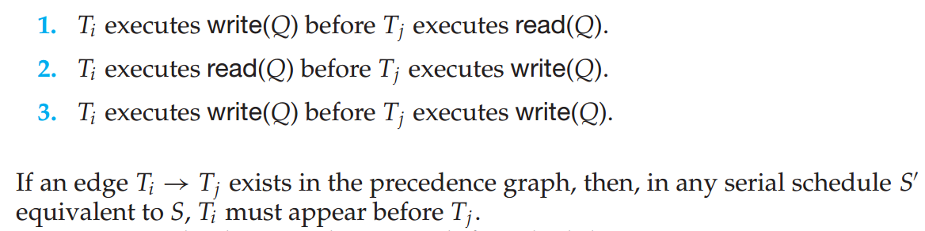
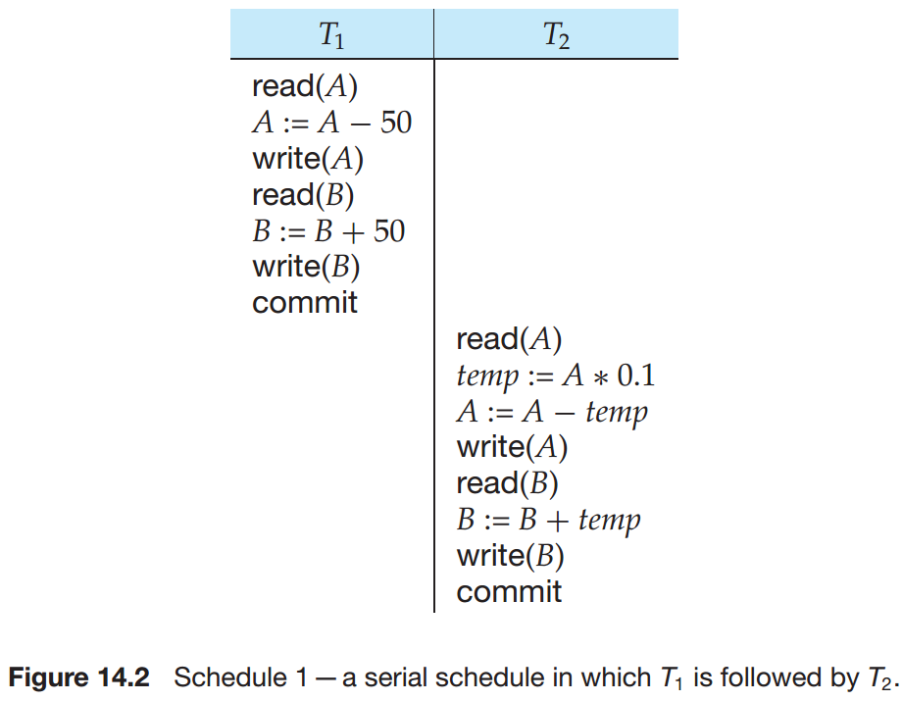
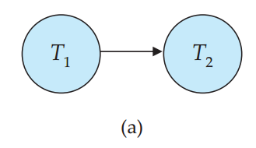
Testing for Serializability
Consider some schedule of a set of transactions T₁, T₂, ..., T_{n}
Precedence graph(优先图) — a direct graph where the vertices are the transactions (names).
We draw an arc from T_{i} to T_{j} if the two transaction conflict, and T_{i} accessed the data item on which the conflict arose earlier.
We may label the arc by the item that was accessed.

Slide 28
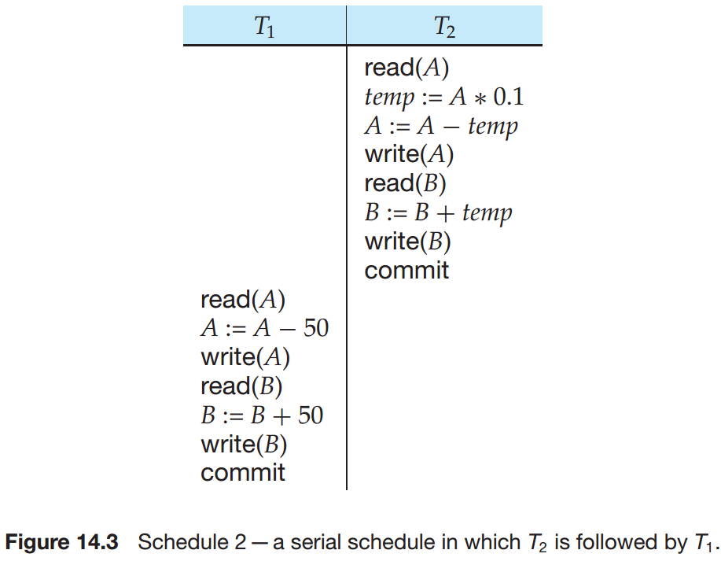
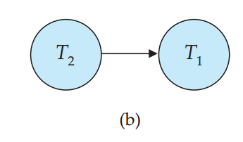

Slide 29
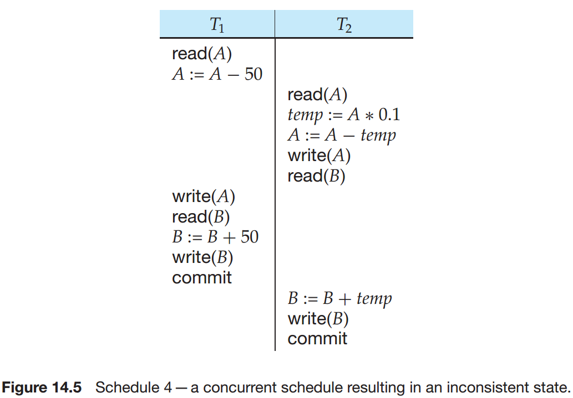
Testing for Serializability
Consider some schedule of a set of transactions T₁, T₂, ..., T_{n}
Precedence graph(优先图) — a direct graph where the vertices are the transactions (names).
We draw an arc from T_{i} to T_{j} if the two transaction conflict, and T_{i} accessed the data item on which the conflict arose earlier.
We may label the arc by the item that was accessed.
Example 1

Slide 30
Testing for Serializability
Consider some schedule of a set of transactions T₁, T₂, ..., T_{n}
Precedence graph(优先图) — a direct graph where the vertices are the transactions (names).
We draw an arc from T_{i} to T_{j} if the two transaction conflict, and T_{i} accessed the data item on which the conflict arose earlier.
We may label the arc by the item that was accessed.
Example 1
（若有环存在，非冲突可串行化）

Slide 31
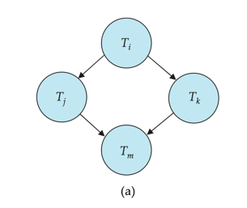
Test for Conflict Serializability
A schedule is conflict serializable if and only if its precedence graph is acyclic（无环的）.
Cycle-detection algorithms exist which take order n² time, where n is the number of vertices in the graph.
(Better algorithms take order n + e where e is the number of edges.)
If precedence graph is acyclic, the serializability order can be obtained by a topological sorting of the graph.

Slide 32
Test for Conflict Serializability
A schedule is conflict serializable if and only if its precedence graph is acyclic（无环的）.
Cycle-detection algorithms exist which take order n² time, where n is the number of vertices in the graph.
(Better algorithms take order n + e where e is the number of edges.)
If precedence graph is acyclic, the serializability order can be obtained by a topological sorting of the graph.

Slide 33
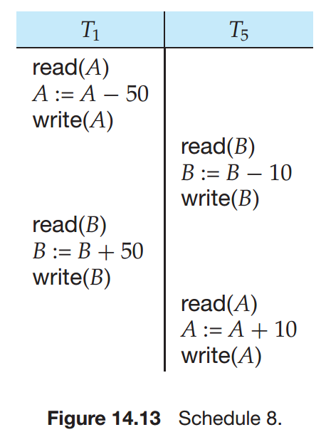
优先图？是否为可串行化？

Slide 34
两个调度，结果相同，但他们不是冲突等价

Slide 35
Recoverable Schedules（可恢复调度）
Need to address the effect of transaction failures on concurrently running transactions.（当事务故障发生时）
Recoverable schedule — if a transaction T_{j} reads a data item previously written by a transaction T_{i} , then the commit operation of T_{i} appears before the commit operation of T_{j}.
The following schedule (Schedule 11) is not recoverable if T₉ commits immediately after the read
If T₈ should abort, T₉ would have read (and possibly shown to the user) an inconsistent database state. Hence, database must ensure that schedules are recoverable.

Slide 36
Cascading Rollbacks（级联回滚）
Cascading rollback – a single transaction failure leads to a series of transaction rollbacks. Consider the following schedule where none of the transactions has yet committed (so the schedule is recoverable) If T₁₀ fails, T₁₁ and T₁₂ must also be rolled back.
Can lead to the undoing of a significant amount of work

Slide 37
Cascadeless Schedules（无级联调度）
Cascadeless schedules — cascading rollbacks cannot occur; for each pair of transactions T_{i} and T_{j} such that T_{j} reads a data item previously written by T_{i}, the commit operation of T_{i} appears before the read operation of T_{j}.
Recoverable schedule — if a transaction T_{j} reads a data item previously written by a transaction T_{i} , then the commit operation of T_{i} appears before the commit operation of T_{j}.

Slide 38
Cascadeless Schedules（无级联调度）
Cascadeless schedules — cascading rollbacks cannot occur; for each pair of transactions T_{i} and T_{j} such that T_{j} reads a data item previously written by T_{i}, the commit operation of T_{i} appears before the read operation of T_{j}.
Recoverable schedule — if a transaction T_{j} reads a data item previously written by a transaction T_{i} , then the commit operation of T_{i} appears before the commit operation of T_{j}.
Every cascadeless schedule is also recoverable

Slide 39
Concurrency Control（并发控制）
A database must provide a mechanism that will ensure that all possible schedules are
either conflict serializable, and
are recoverable and preferably cascadeless
A policy in which only one transaction can execute at a time generates serial schedules, but provides a poor degree of concurrency
Are serial schedules recoverable/cascadeless?
Testing a schedule for serializability after it has executed is a little too late!
Goal – to develop concurrency control protocols（协议） that will assure serializability.

Slide 40
Concurrency Control vs. Serializability Tests
Concurrency-control protocols allow concurrent schedules, but ensure that the schedules are conflict serializable, and are recoverable and cascadeless .
Concurrency control protocols generally do not examine the precedence graph as it is being created
Instead a protocol imposes a discipline that avoids nonseralizable schedules.
We study such protocols in Chapter 16.
Different concurrency control protocols provide different tradeoffs between the amount of concurrency they allow and the amount of overhead that they incur.
Tests for serializability help us understand why a concurrency control protocol is correct.

Slide 41
End of Chapter 14

